Slide 1
Engineering Physics Course
Dr. Dhanalakshmi B M.Sc., Ph.D.

Slide 2
Unit-II (Cotn.) Crystal Planes & X-ray Diffraction

Slide 3
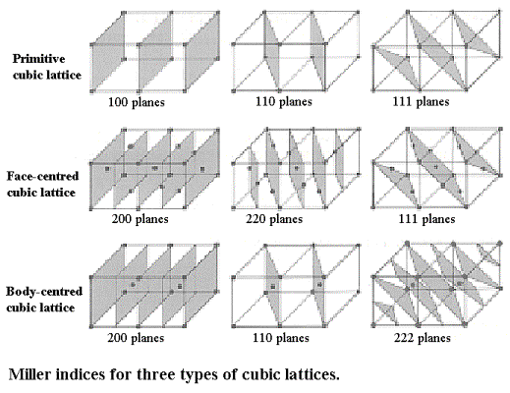

Slide 4
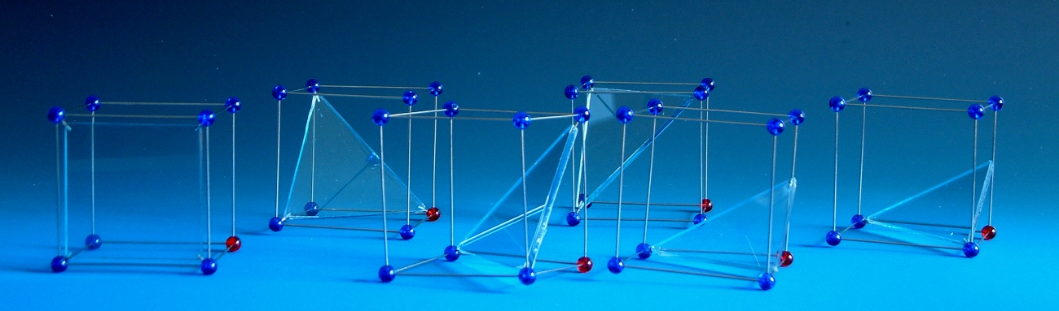

Slide 5
Z
c
b
a
Y
X

Slide 6

Z
r*c
c
a
b
q*b
p*a
Y
X
Intercept of X-axis = pa
Intercept of Y-axis = qb
Intercept of Z-axis = rc

Slide 7
Z
c
b
Y
X
a
(1 0 0)

Slide 8
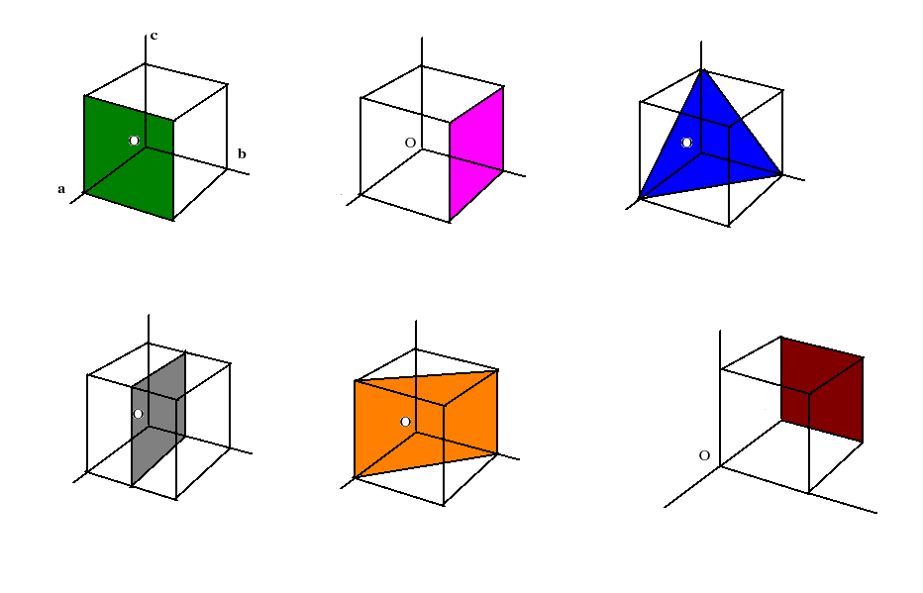
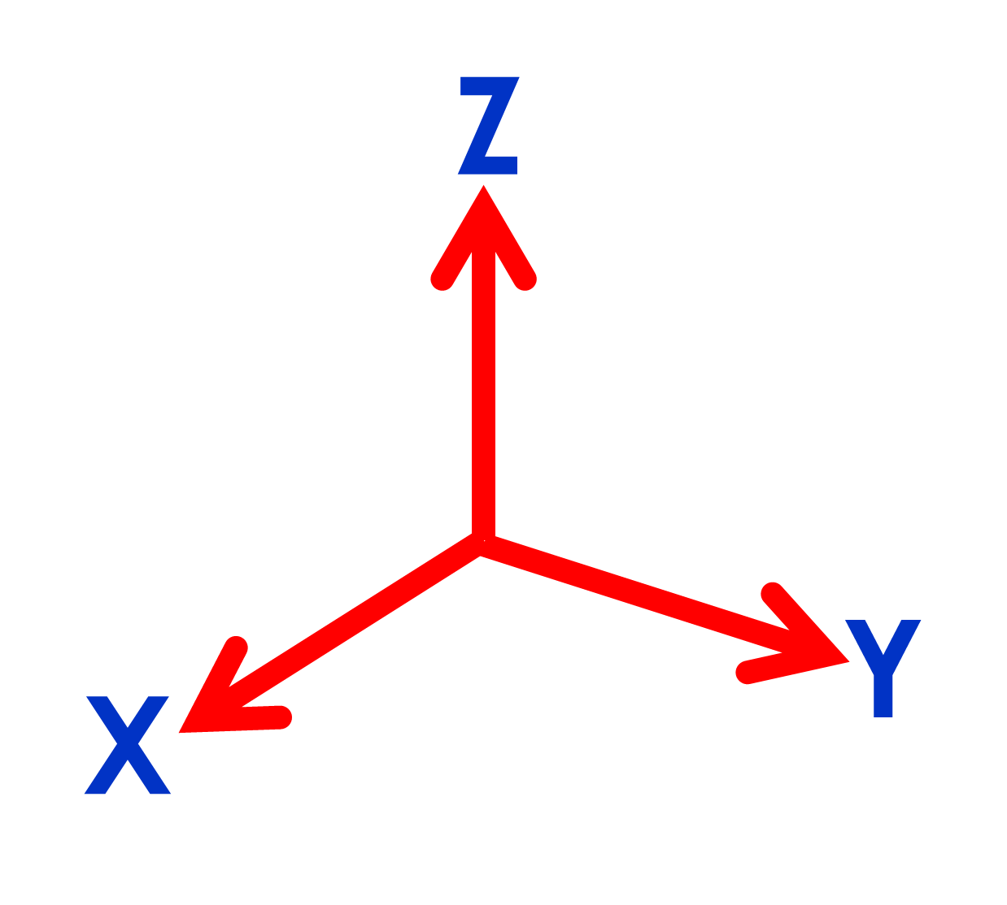
c
c
b
b
a
a
c
c
c
b
b
a
a
a
b

Slide 9
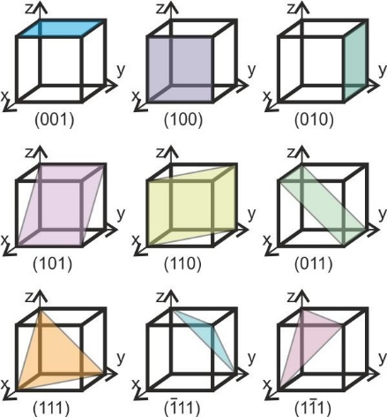

Slide 10
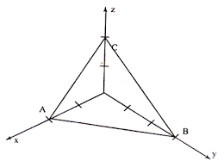
MILLER INDICES
Miller indices are the smallest integers (h k l) that represent a plane.
Obtaining or finding Miller indices
First determine the intercepts on crystallographic axis
Take reciprocals
Multiply with L.C.M of denominators
Place them in close curved brackets as (h k l)
Important features of Miller indices
Family of planes has same Miller indices
Plane parallel to any one of the axis, its intercept is infinity and Miller index is zero.
Any Miller index is negative represent by putting bar on it (ex : -3 as 3 ̅ )
For same Miller indices, plane and direction are always perpendicular.

Slide 11
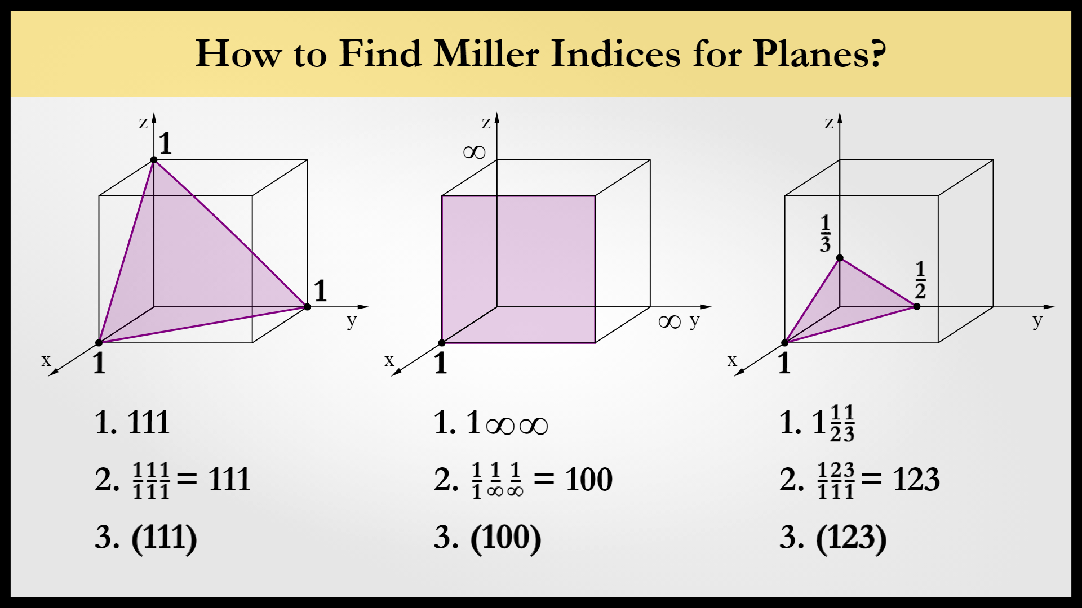

Slide 12
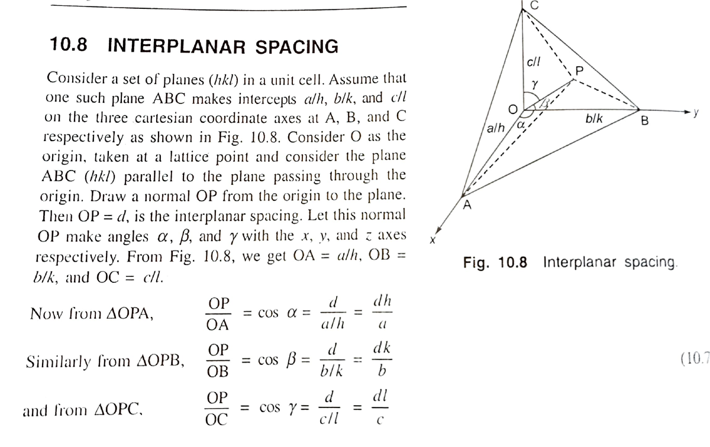

Slide 13
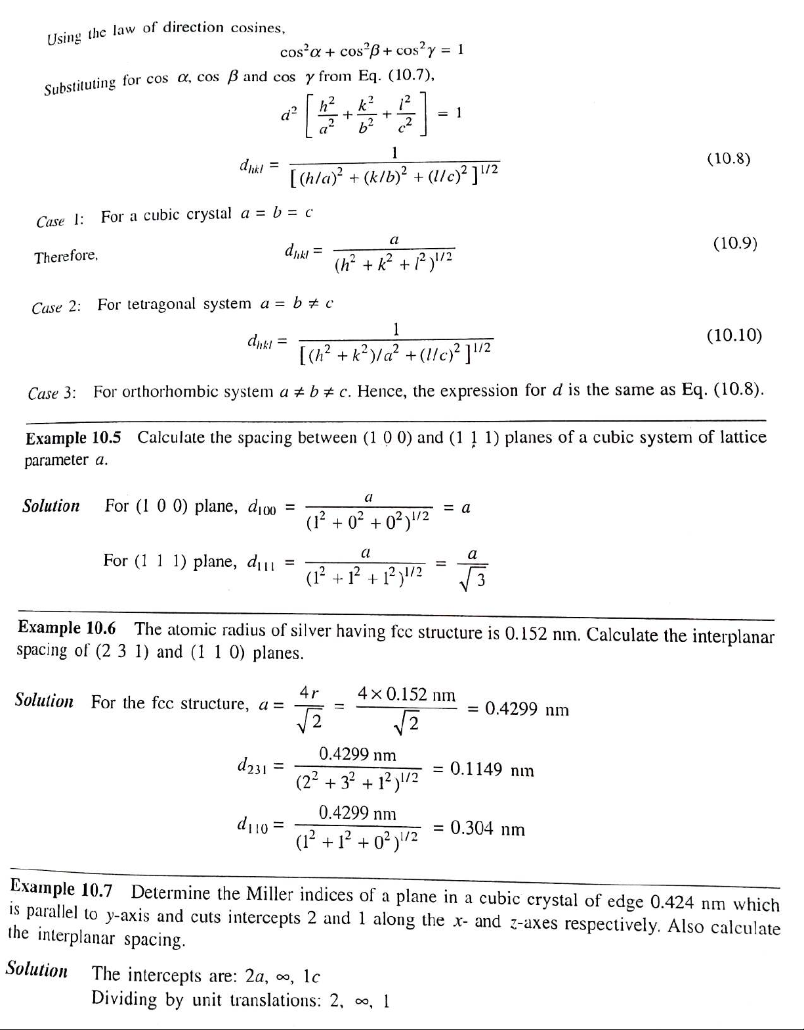
Using the law of direction cosines

Slide 14
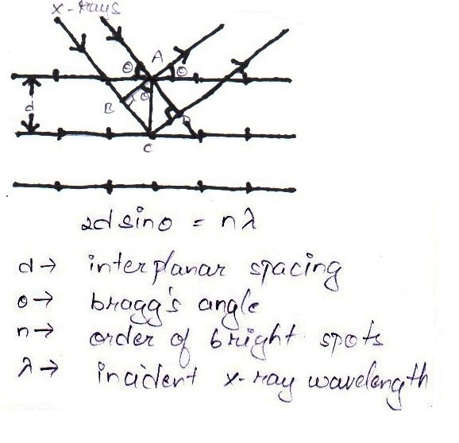
BRAGG’S LAW
Statement: Diffracted X-rays from a crystal give bright spot on screen if path difference of X-rays
2dsinθ = nλ
Proof:
From triangle ABC and ACD
Path difference (BC+CD) = nλ
= dsinθ + dsinθ = nλ
= 2dsinθ = nλ

Slide 15
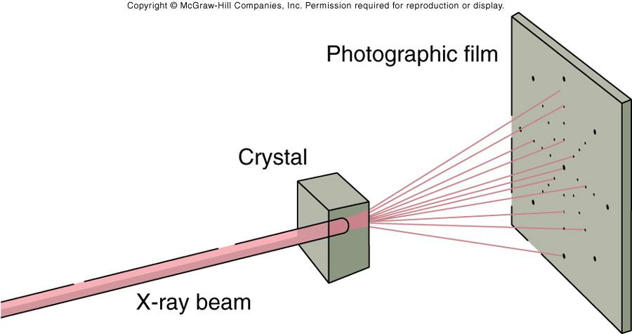

Laue’s Method
The Laue method is often used to determine the orientation of single crystals and identification of crystal structure.

Slide 16
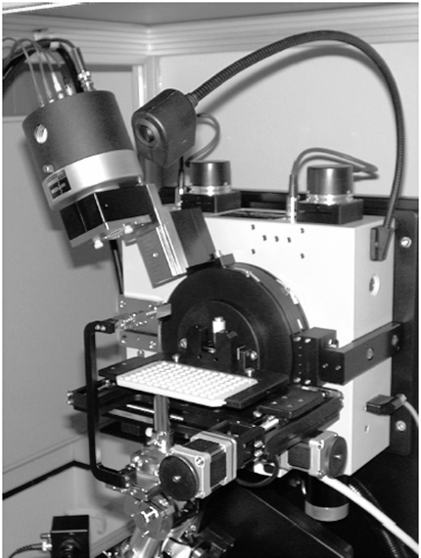
Photograph of a
XRD Diffractometer

